Slide 1

How to update kernel manually
Step by step guide

Slide 2
Prerequisites
Get the access of the Linux system of which kernel needs to be updated
Confirm which kernel on the system already
Confirm which version of the kernel needs to be downloaded

Slide 3
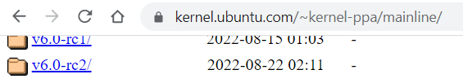
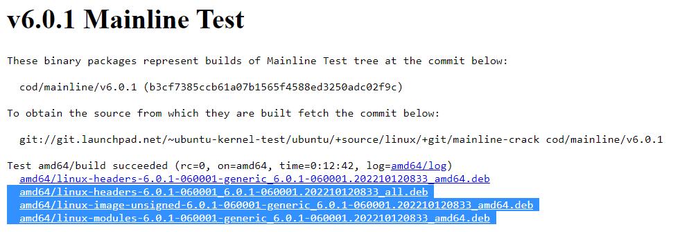
Step – Download files
Create new folder in Linux using below command.
mkdir kerner_folder
Open link
https://kernel.ubuntu.com/~kernel-ppa/mainline/
Only download the last 3 packages on Linux
wget <generic files for
headers_all, images and modules>

Slide 4
Step - install
cd to above created new folder and install the deb pkgs using below cmd.
sudo dpkg -i *.deb
Copy details from execution of below commands
grep submenu /boot/grub/grub.cfg
grep gnulinux /boot/grub/grub.cfg
Now put copied text in notes for further use

Slide 5
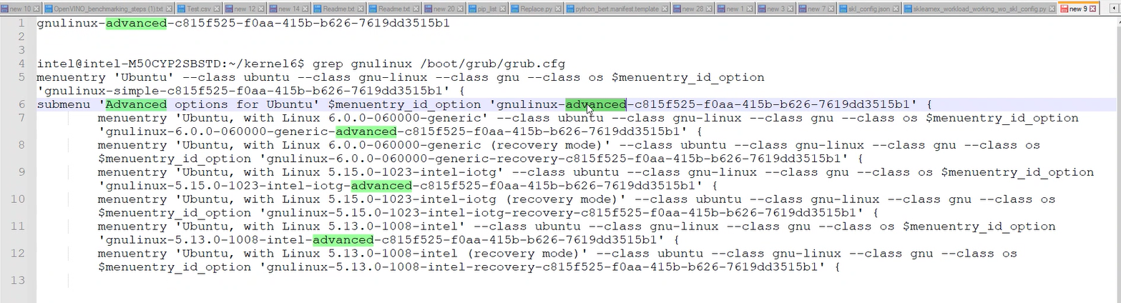
Now look for ‘gnulinux’ word in second copied text which is followed by first instance of ‘menuentry’ word

Slide 6
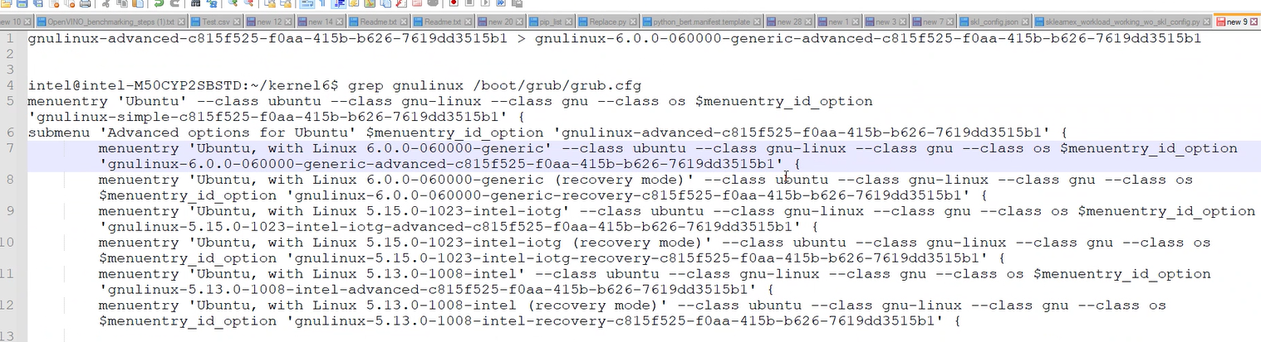
Copy whole text from line 7 to the line 1

Slide 7
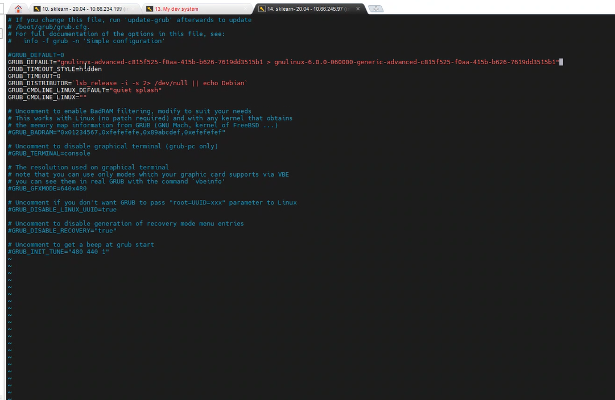
Now open grub file to update value for GRUB_DEFAULT
sudo vim /etc/default/grub

Slide 8
Run below 2 commands
sudo update-grub
sudo grub-mkconfig -o /boot/efi/EFI/ubuntu/grub.cfg
And Reboot system
To check new kernel, run below command
Uname -r

